Slide 1
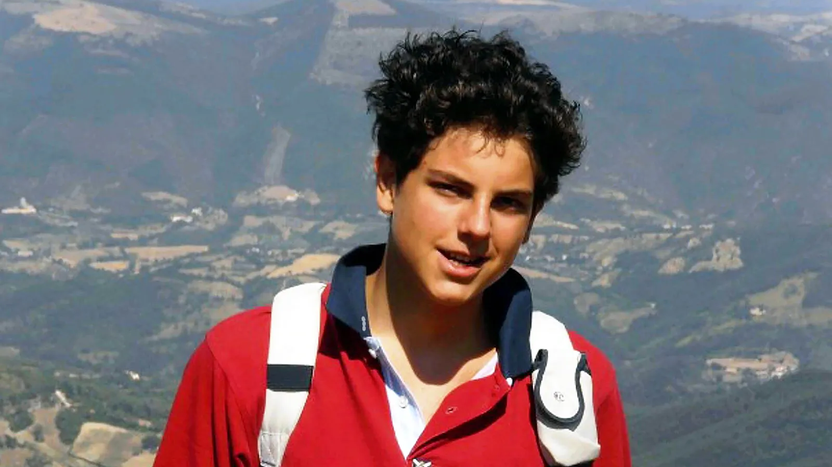
The Canonisation of Carlo Acutis
Notes:
During our time together we will:
Understand the life of Carlo Acutis and the significance of his canonisation.
Explore the process of canonisation in the Catholic Church.
Reflect on how Carlo Acutis' life can inspire young people in their faith.
Discuss how technology and social media can be used to spread faith.
Warm-Up Question: "What does it mean to be a modern-day saint?" or "Can someone be a saint even if they use technology a lot?"
Briefly introduce Carlo Acutis as a teenager who was known for his love of technology, computers, and his deep faith in God. Mention how he used his skills to spread the message of the Eucharist and faith to a wider audience through websites and media.

Slide 2
What does it mean to be a saint in the Catholic Church?
Notes:
Ask the students, "What do we mean when we call someone saint in the Catholic Church?" Discuss briefly.
Points to draw out:
While earthly titles and personal CV’s may matter to employers, they do not matter to God. In fact, the only “title” God cares about for us is that we are His son or daughter.
To be clear, the Church doesn’t “make someone” a saint. The Church recognises the holiness of certain individuals and honours some with the title of “saint.” If you make it to heaven, you are a saint – whether or not the Church recognises you as one publicly.
The title of saint is conferred on someone after what is called the canonisation process. A canonised saint in the Catholic Church is a person who is officially recognized as having lived a life of heroic virtue while on earth.
The word itself is derived from the Latin word sanctus, meaning "holy," and in general refers to all the faithful who strive after a life of holiness.
However, the most common usage is in referring to those men and women who lead exemplary lives of holiness.
Whether your life is ever investigated or a statue ever chiselled, the good news is that God has given us every opportunity to become saints in our everyday life. He’s given us the Sacraments to ensure we become holy and the saints to offer a model of life and example of prayer. The only thing missing is your consent to allow the Holy Spirit to make you a saint.
Activity: Ask students to recall their favourites saint (this could be their confirmation saint, a saint they particularly like, or even just a saint they know something about). Can they identify what about them made them so special? Based on what they've discussed, and what they've learned about Bl Carlo Acutis, ask them to consider what a saint in our times would look like. Ask students to create a “modern saint” profile (if Carlo Acutis were alive today, what would he be doing to use technology for good?). What qualities would they have? What kind of lives would they lead? What would they be able to show us about holiness?

Slide 3
Notes:
Closer look at Bl Carlo Acutis
Presentation or Video: Play embedded video about Carlo’s life, focusing on key moments:
Born in 1991 in Italy.
His deep devotion to the Eucharist and the Catholic faith.
How he used technology to spread faith (e.g., his website on Eucharistic miracles).
His early death at 15 due to leukaemia.
The miracles attributed to his intercession, leading to his beatification in 2020.
Discussion:
Ask students: "What strikes you about Carlo's life?" (Focus on his youth, faith, and use of technology).

Slide 4
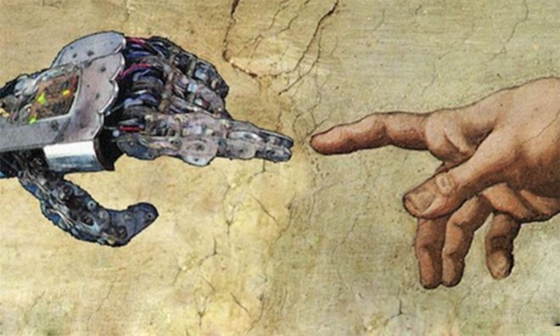
Technology and Faith
How do you think technology can be used for good?
Can we use technology to grow closer to God?
What might Carlo Acutis say to us about using our devices and social media?
Notes:
Reflection on Technology and Faith
Discussion: Ask students to discuss:
How do you think technology can be used for good?
Can we use technology to grow closer to God?
What might Carlo Acutis say to us about using our devices and social media?

Slide 5
Notes:
At the centre of Carlo’s life was the Eucharist, which he famously referred to as his “highway to heaven.” He firmly believed in the Real Presence of Jesus in the Eucharist— the Catholic teaching that in the consecrated host, Jesus Christ is truly present, body, blood, soul, and divinity. For Carlo, the Eucharist was not just a symbol or a ritual, but a living encounter with Jesus, the source of grace and strength for his daily life.
Blessed Carlo Acutis Carlo once said,
“The more we receive the Eucharist, the more we will become like Jesus, so that on this earth we will have a foretaste of heaven.”
He understood that the Eucharist was the key to growing in holiness and becoming more united with Christ. His frequent reception of the Eucharist, his time spent in Eucharistic Adoration, and his unwavering belief in the transformative power of the sacrament were the hallmarks of his spiritual life.
Blessed Carlo’s devotion to the Eucharist is a powerful reminder to all Catholics of the importance of this central sacrament in our faith. In a world that often overlooks the sacred, Carlo’s example challenges us to rediscover the awe and reverence that the Eucharist deserves.
How Can I be More Like Carlo? Reflection Activity (see worksheet)

Slide 6
O God our Father, we thank you for giving us Carlo, a model of life for young people, and a message of love for all. You made him fall in love with your son Jesus, making the Eucharist his “highway to heaven.” You gave him Mary as a beloved mother, and you made him, through the Rosary, a cantor of her tenderness. Receive his prayer for us.
Look above all upon the poor, whom he loved and assisted. Grant me too, through his intercession, the grace that I need (mention your intention). And make our joy full, raising Carlo among the saints of your Church, so that his smile shines again for us to the glory of your name.
Amen
Notes:
Draw the Lesson to a close by using the Official Prayer of Blessed Carlo Acutis

